Slide 1
State of the Literature - LLMs
AIAC Tech Review
June 20, 2023 (not a second later)
Luke Ross

Slide 2
Topics
Intro: LLMs and RLHF
Fine-Tuning Language Models from Human Preferences
Learning to summarize from human feedback
InstructGPT
Language Model Scaling
Chinchilla
Llama
Emergent Abilities of Large Language Models
Are Emergent Abilities of Large Language Models a Mirage?
Fine-Tuning Approaches
LoRA
Alpaca
Vicuna
LIMA: Less Is More for Alignment
Evaluation
False Promise of Imitating Proprietary LLMs
How Far Can Camels Go?
Orca
Open LLM Leaderboard
Quantization
QLoRA
SpQR
RLHF & Alternatives
Direct Preference Optimization
RL4F

Slide 3
Intro: LLMs + RLHF

Slide 4
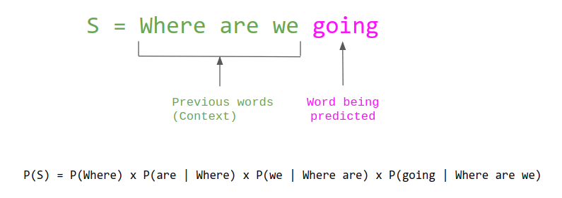
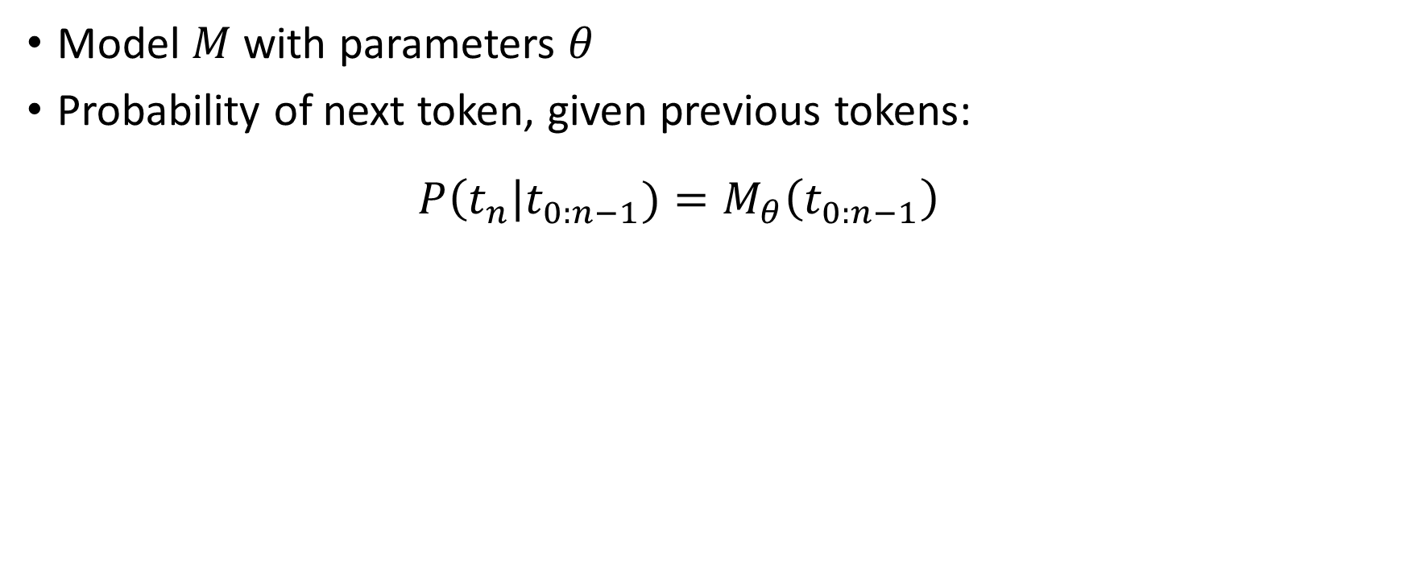
LLM: Large Language Model
Model $M$ with parameters $θ$
Probability of next token, given previous tokens:
$$P\left(t_{n}\right|t_{0:n−1})=M_{θ}\left(t_{0:n−1}\right)$$

Slide 5
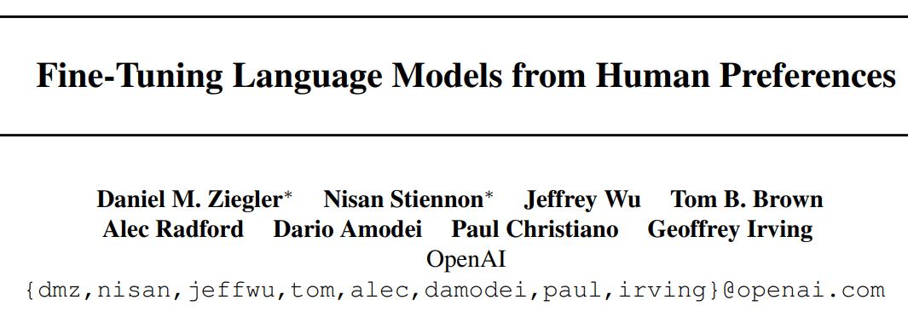
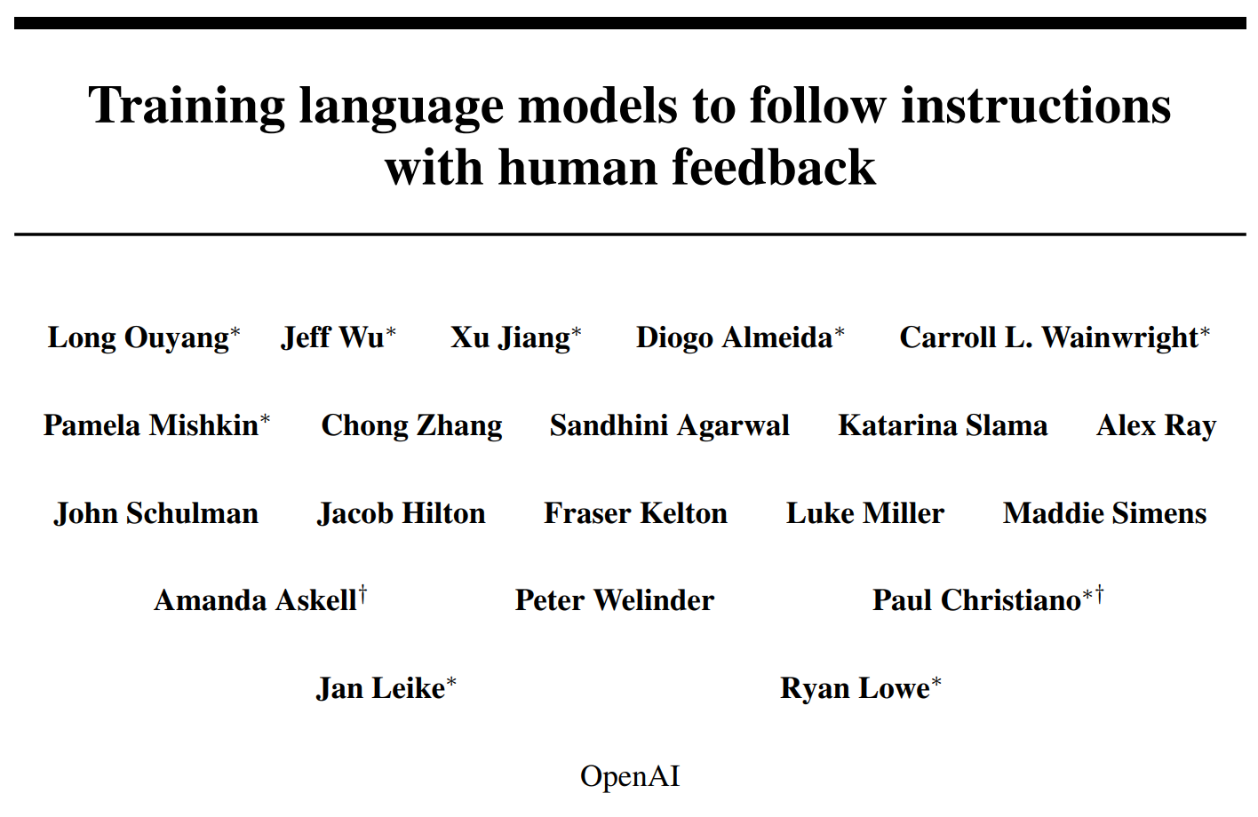
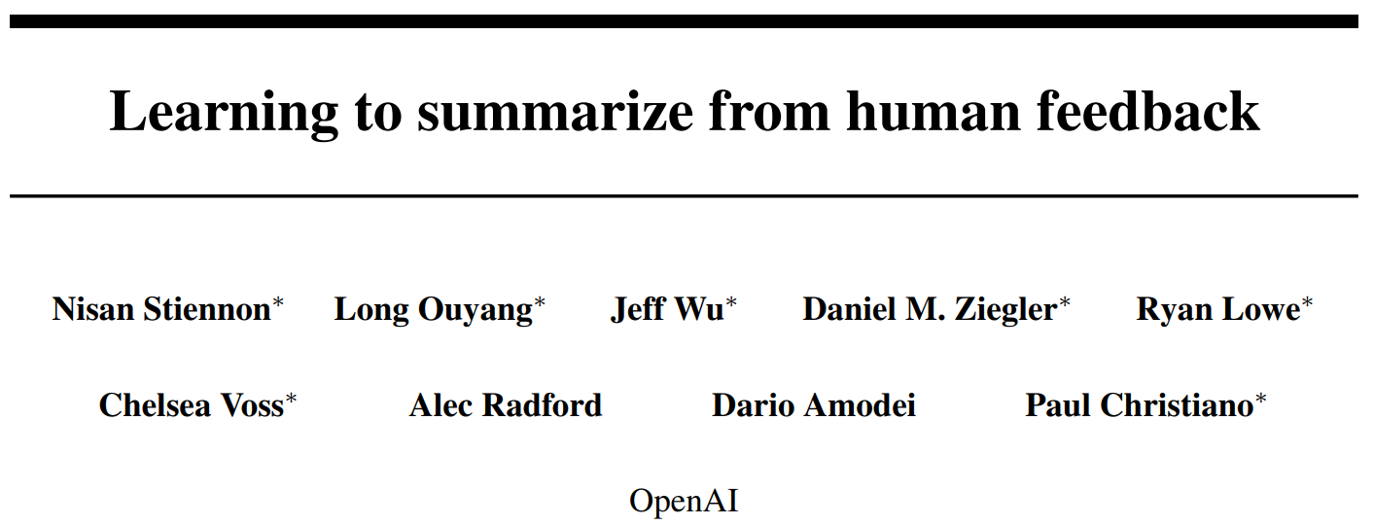
RLHF: Reinforcement Learning from Human Feedback
Initial Idea
Instruction Finetuning (~GPT3.5)
Applied to Summarization

Slide 6
RLHF - Motivation
Generative evaluation metrics are low quality
Maximum Likelihood Objective (SFT) punishes all errors the same
Hallucinations just as bad as synonym replacement
Sensitive to low quality ground truth
LM “completions” != instruction following
Solution: directly align with human preferences

Slide 7
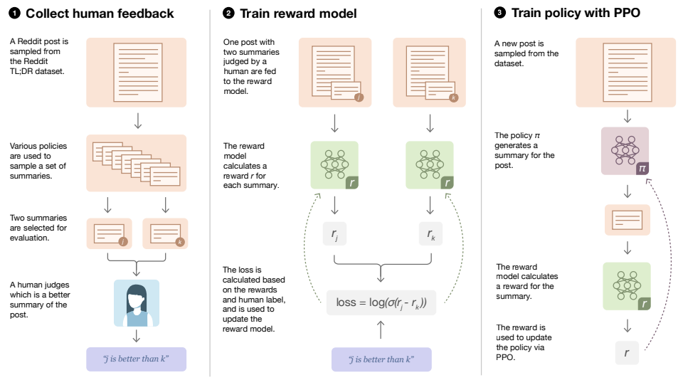
Approach
0. Begin with a supervised model
Send output pairs to humans, who choose the better output among:
Latest RLHF model output
Initial supervised model output
Ground truth labels
Other baseline models
Train a Reward Model (RM) to predict preferred output
Train supervised model w/ RL, using RM logit score as reward

Slide 8
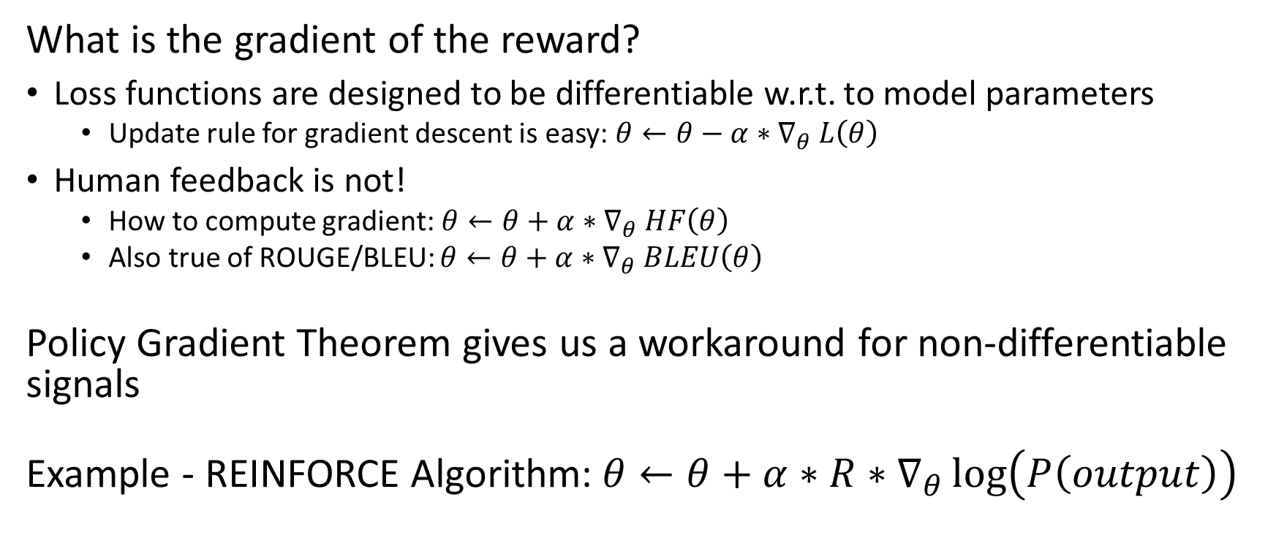
Why Reinforcement Learning?
What is the gradient of the reward?
Loss functions are designed to be differentiable w.r.t. to model parameters
Update rule for gradient descent is easy: $θ←θ−α{∗∇}_{θ}L\left(θ\right)$
Human feedback is not!
How to compute gradient:$θ←θ+α{∗∇}_{θ}HF\left(θ\right)$
Also true of ROUGE/BLEU: $θ←θ+α{∗∇}_{θ}BLEU\left(θ\right)$
Policy Gradient Theorem gives us a workaround for non-differentiable signals
Example - REINFORCE Algorithm:$θ←θ+α∗R∗∇_{θ}\log\left(P\left(output\right)\right)$
Step in this direction increases loss
Step in this direction increases (log) probability of model output

Slide 9
Language Model Scaling

Slide 10
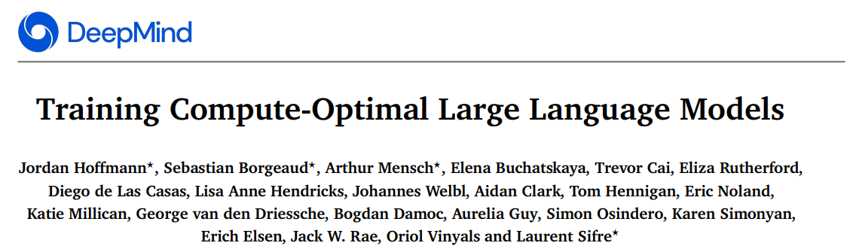
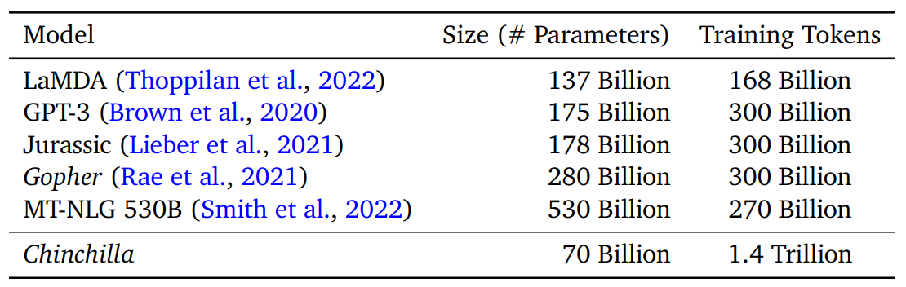
Motivation: for a fixed training budget (FLOPS), how to tradeoff model size (params) and dataset size (tokens)
Findings:
Most LLMs are under-trained
Want ~20 training tokens per
parameter

Slide 11
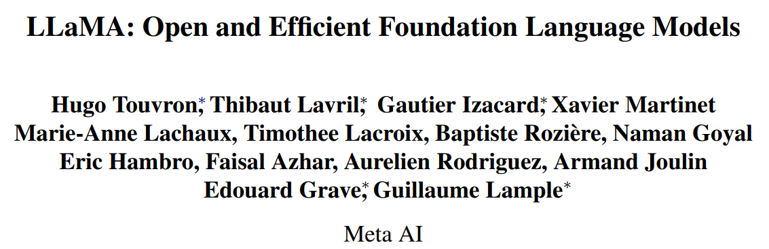
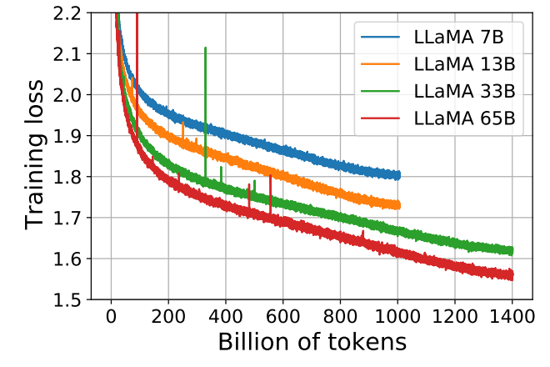
Motivation: how to tradeoff model/dataset size for both training and inference costs?
Findings:
Small models continue to improve
long after Chinchilla-optimal token count
Possible to get SOTA LLM with no
proprietary data (public data only)

Slide 12
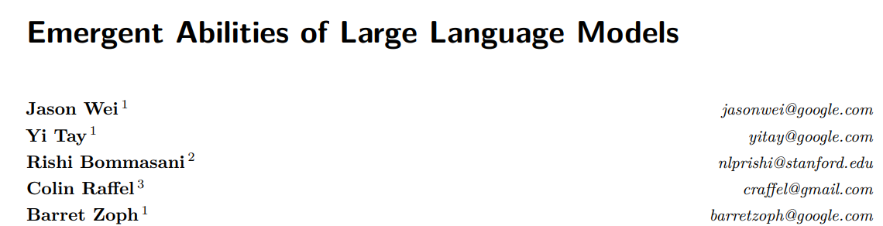
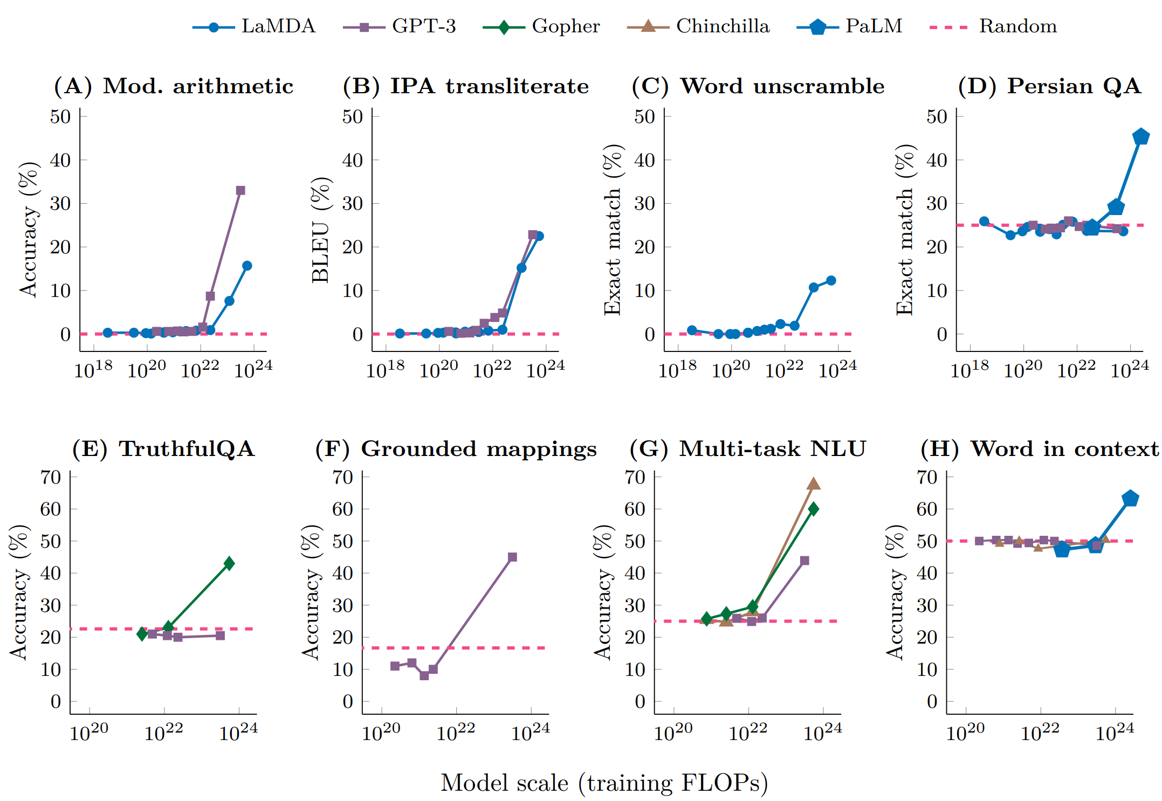
Emergence: While scaling laws predict smooth decreases in loss, certain downstream tasks improve sharply & unpredictably w/ scale

Slide 13
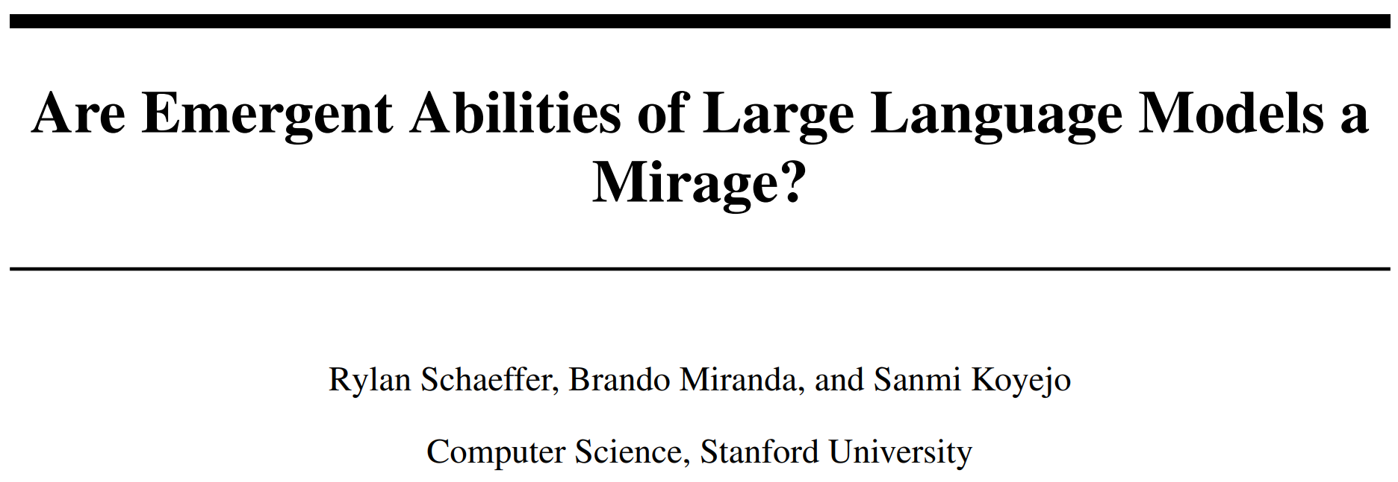
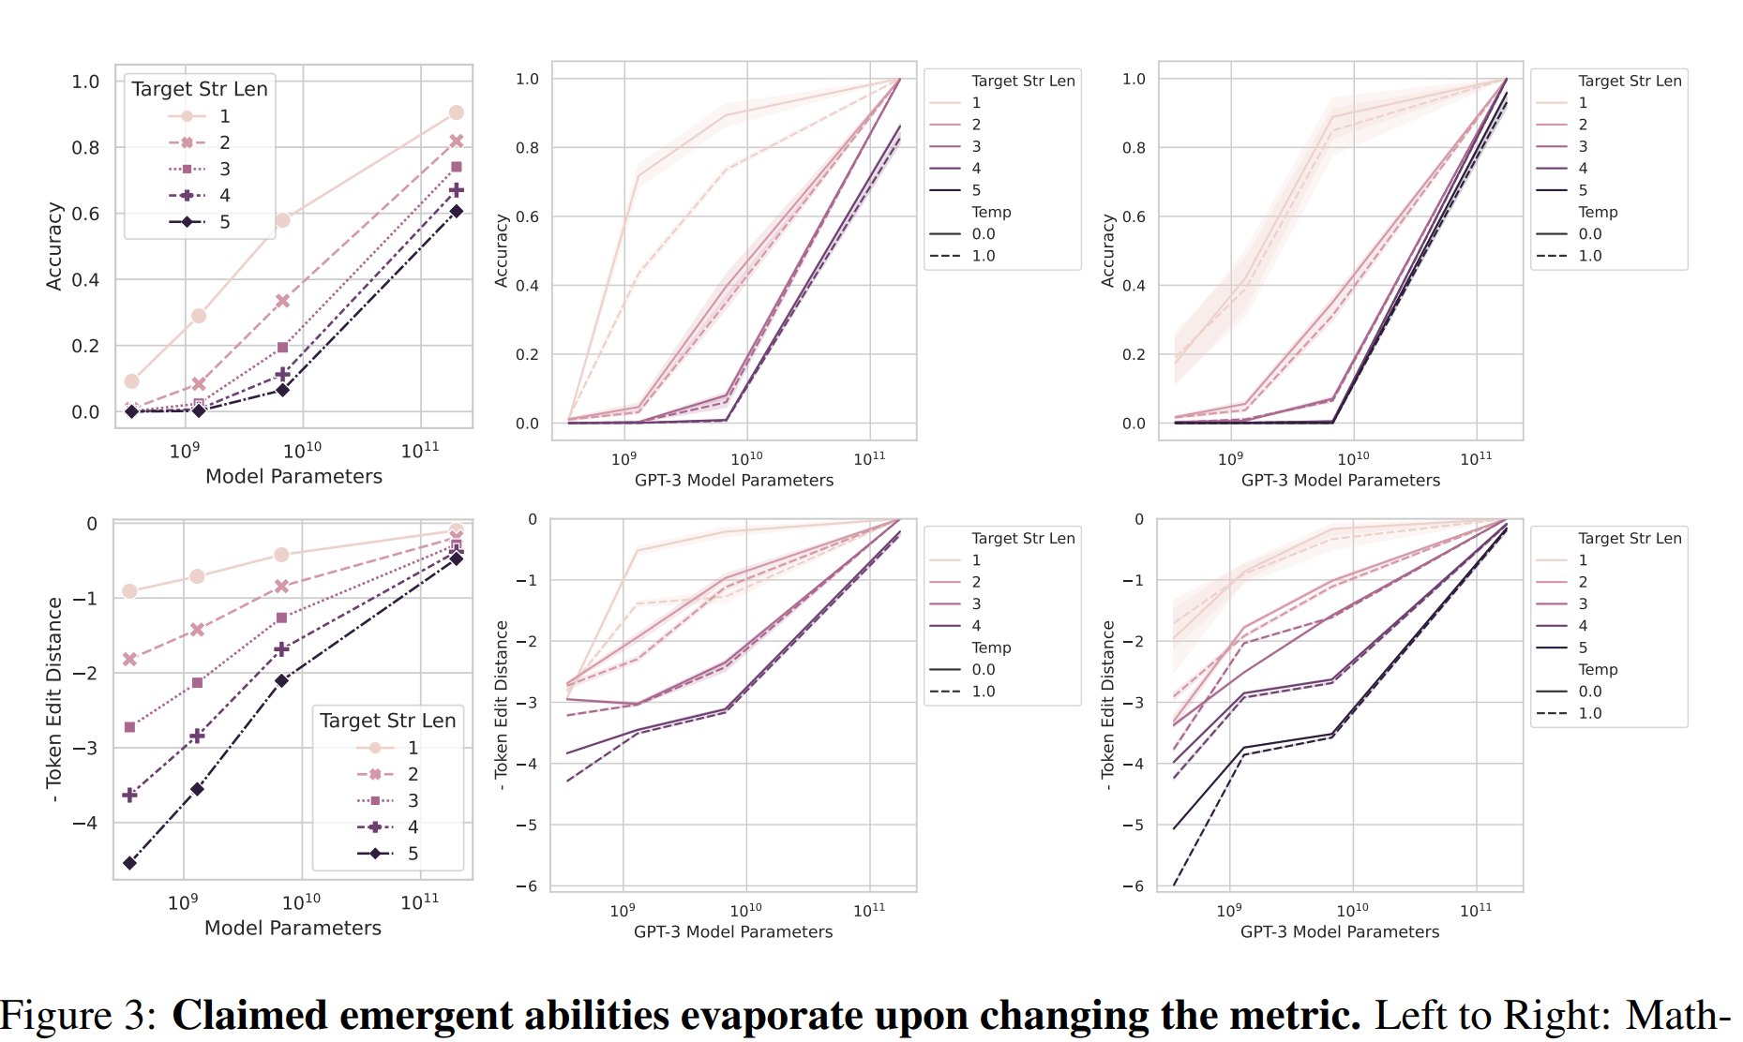
Emergence can be largely (not entirely) explained by:
Nonlinear/discontinuous metrics:

Slide 14
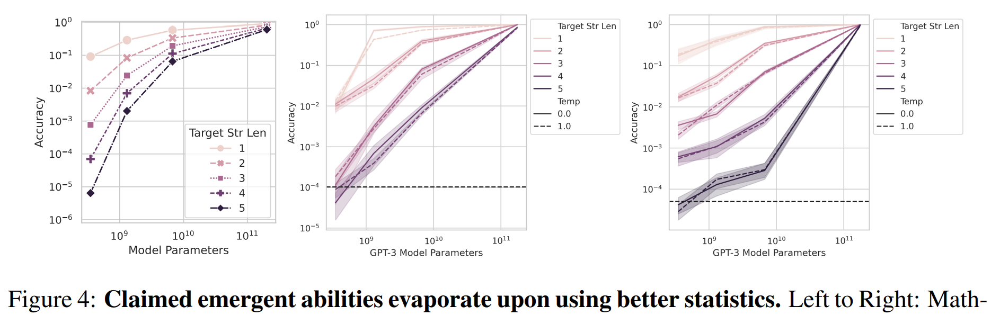
Emergence can be largely (not entirely) explained by:
Nonlinear/discontinuous metrics
Small Test sets
Note the log-scale!

Slide 15
Fine-Tuning

Slide 16
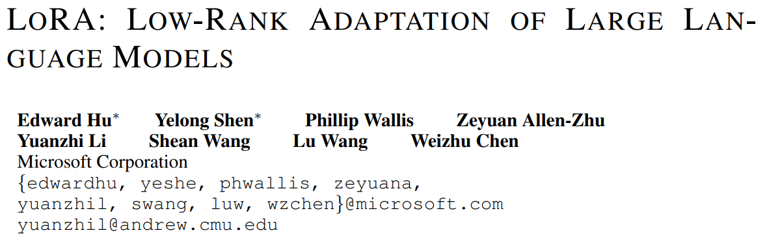
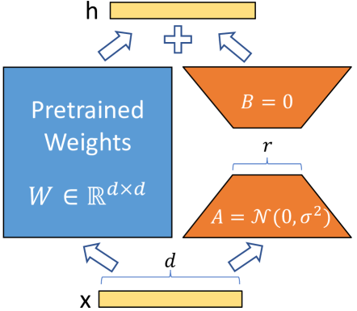
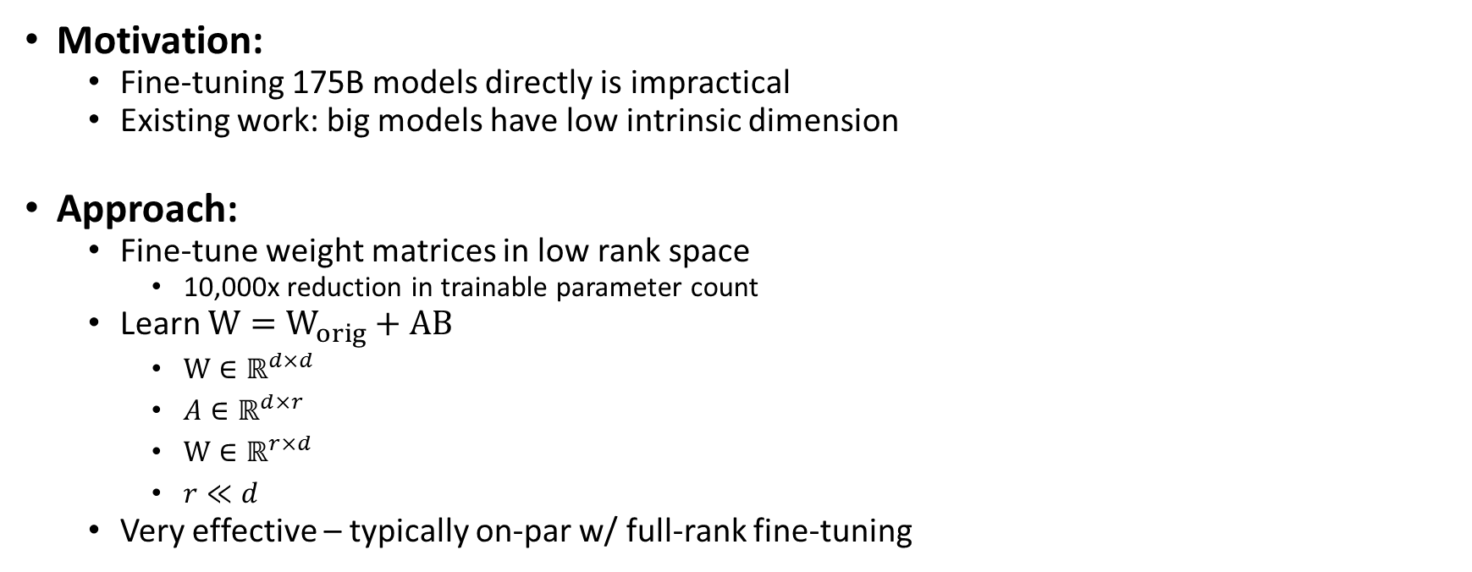
Motivation:
Fine-tuning 175B models directly is impractical
Existing work: big models have low intrinsic dimension
Approach:
Fine-tune weight matrices in low rank space
10,000x reduction in trainable parameter count
Learn $W=W_{orig}+AB$
$W∈ℝ^{d×d }$
$A∈ℝ^{d×r }$
$W∈ℝ^{r×d }$
$r≪d$
Very effective – typically on-par w/ full-rank fine-tuning

Slide 17

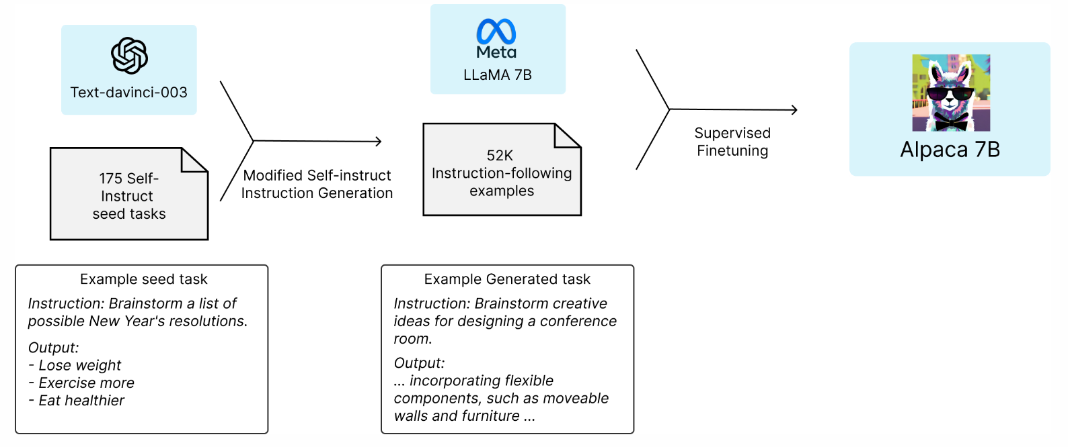
Motivation: Can we rival ChatGPT on an academic budget?
Approach:
Take Llama-7B as foundation model ($0)
Generate 52k instruction prompts + corresponding outputs using APIs (<$500)
Fine-tune foundation model directly – no RLHF (<$100)
Results:
Blind comparison w/ ChatGPT:
Alpaca: 90/179
ChatGPT: 89/179
First to show simple imitation
models can compete
179 is a tiny evaluation set

Slide 18
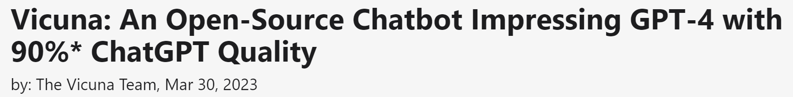
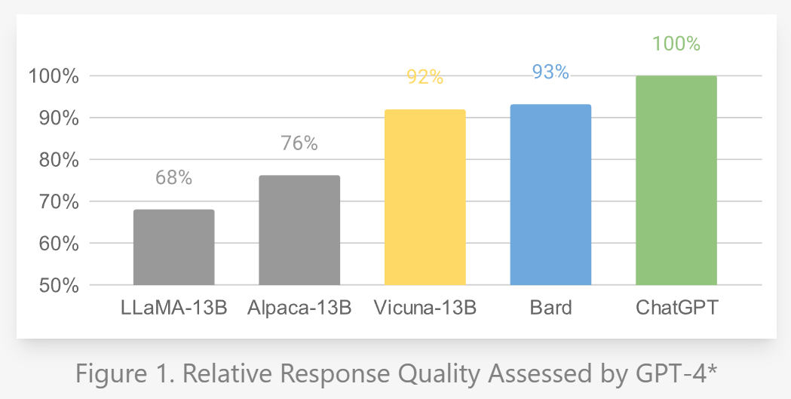
Motivation: Improve on Alpaca by increasing training/eval budget
Approach:
Take Llama-7B/13B as foundation model(s) ($0)
Take 70k user-shared ChatGPT conversations from ShareGPT ($0)
Multi-turn conversations, context length 512 → 2048
Fine-tune foundation model(s) directly – no RLHF ($140/$300)
Evaluate using GPT-4
Results:
GPT-4 thinks Vicuna is almost as
good as ChatGPT

Slide 19
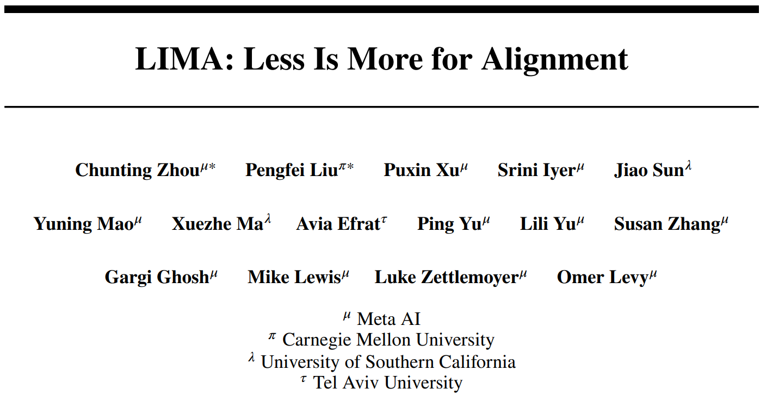
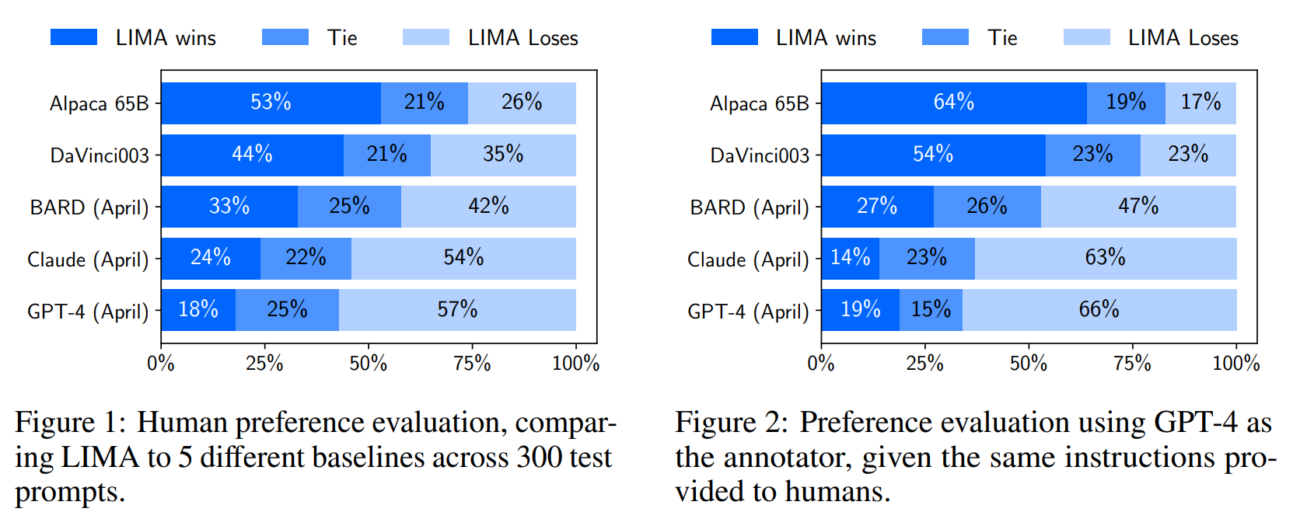
Question: Foundation models are very powerful – how much data is really needed for instruction-finetuning?
Results:
Superficial Alignment Hypothesis: A model’s knowledge and capabilities are learnt almost entirely during pretraining
Data quality >> data quantity
Carefully curated 1k dataset out-performs
automatically generated 52k dataset →

Slide 20
Evaluation

Slide 21
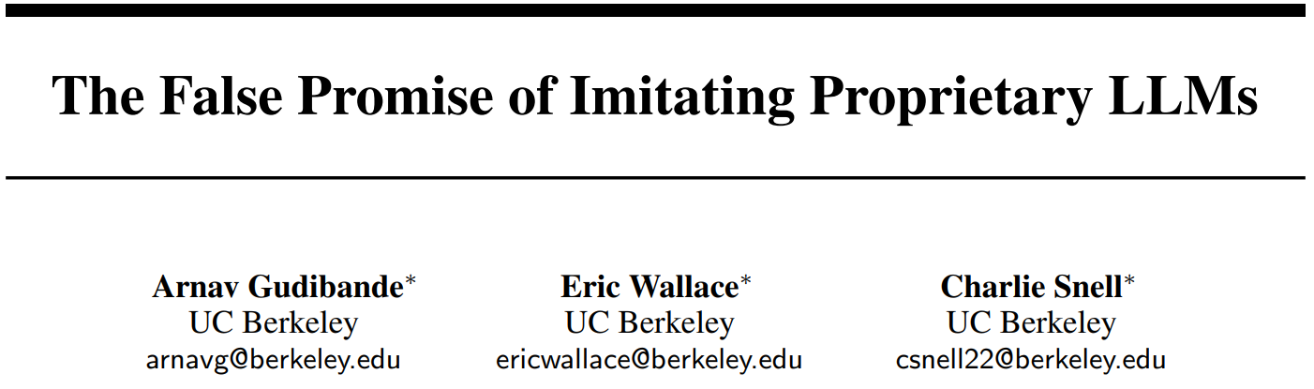
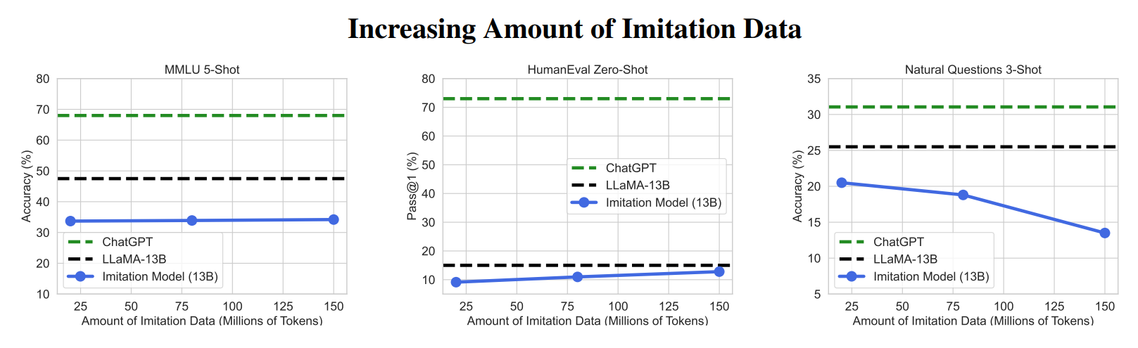
Motivation: Many claims of “90% as good as ChatGPT” with shaky evaluation
Approach: Rigorous benchmark-based evaluation
Results:
Increasing imitation data does not improve factuality

Slide 22
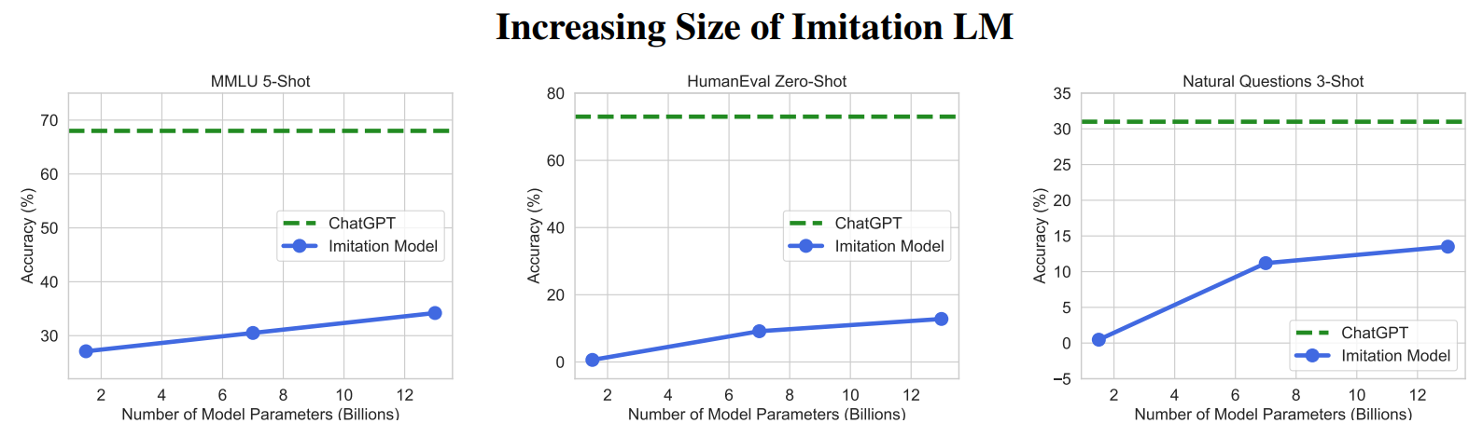
Motivation: Many claims of “90% as good as ChatGPT” with shaky evaluation
Approach: Rigorous benchmark-based evaluation
Results:
Increasing imitation data does not improve factuality
Increasing foundation model scale does improve factuality

Slide 23
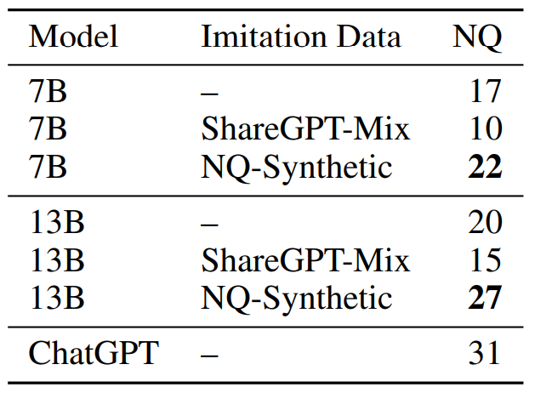
Motivation: Many claims of “90% as good as ChatGPT” with shaky evaluation
Approach: Rigorous benchmark-based evaluation
Results:
Increasing imitation data does not improve factuality
Increasing foundation model scale does improve factuality
Imitation models do improve on tasks supported in the
imitation data
This is a viable training recipe!

Slide 24
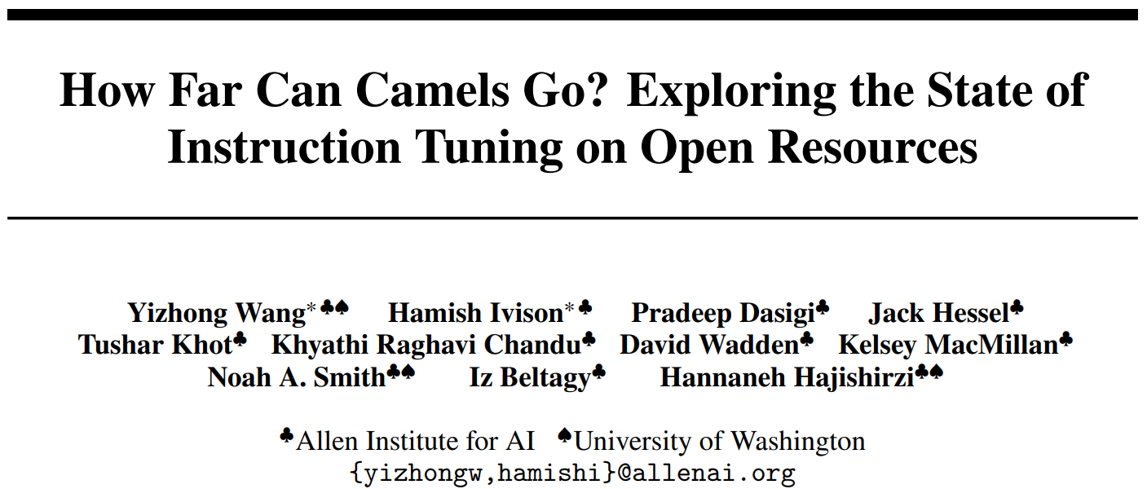
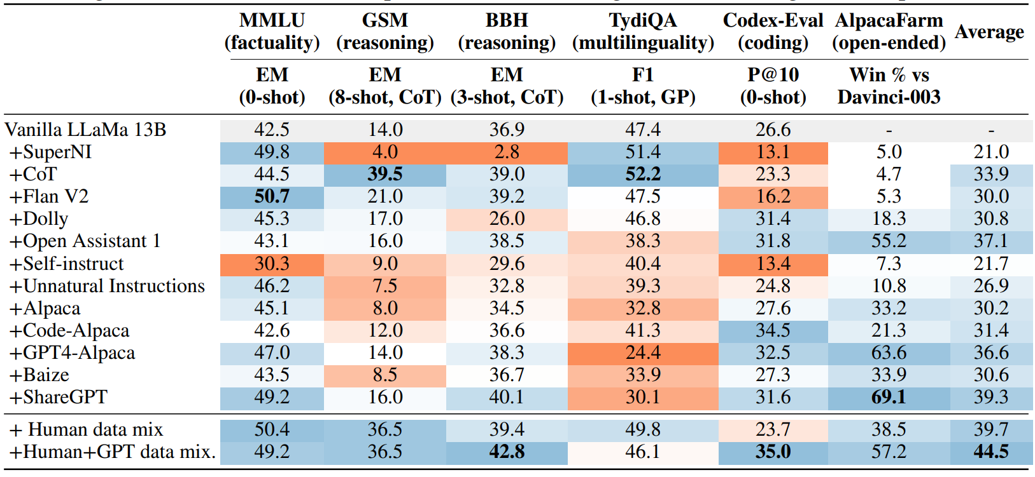
Motivation: Lots of independent instruction tuning datasets – which to use?
Approach: Systematic eval over many datasets (manual + synthetic) and criteria (factual knowledge, reasoning, multilinguality, coding, and open-ended instruction following)
Results:
No single best dataset
Combinations do best overall but
not on individual benchmarks
Base model quality very important

Slide 25
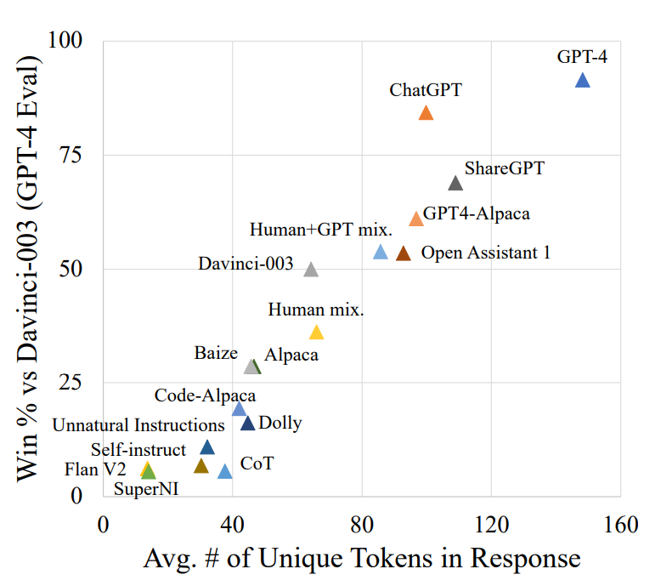
Motivation: Lots of independent instruction tuning datasets – which to use?
Approach: Systematic eval over many datasets (manual + synthetic) and criteria (factual knowledge, reasoning, multilinguality, coding, and open-ended instruction following)
Results:
No single best dataset
Combinations do best overall but
not on individual benchmarks
Base model quality very important
GPT-4 eval likes longer generations

Slide 26
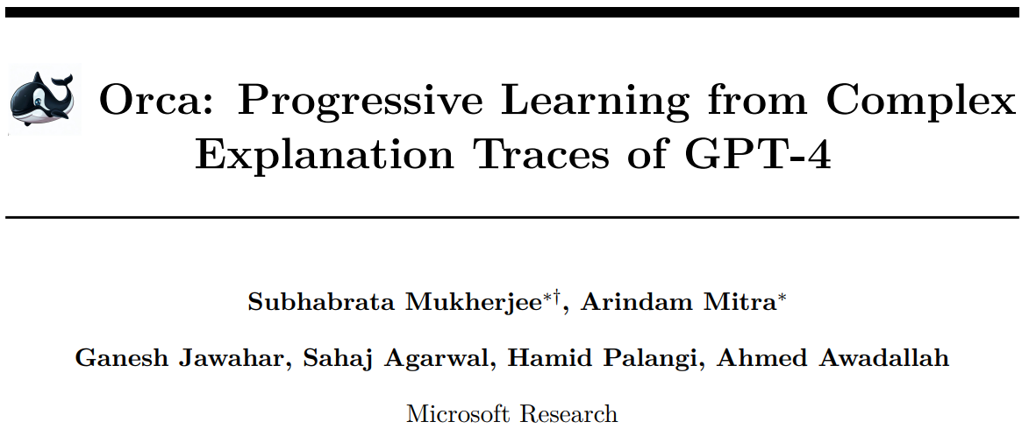
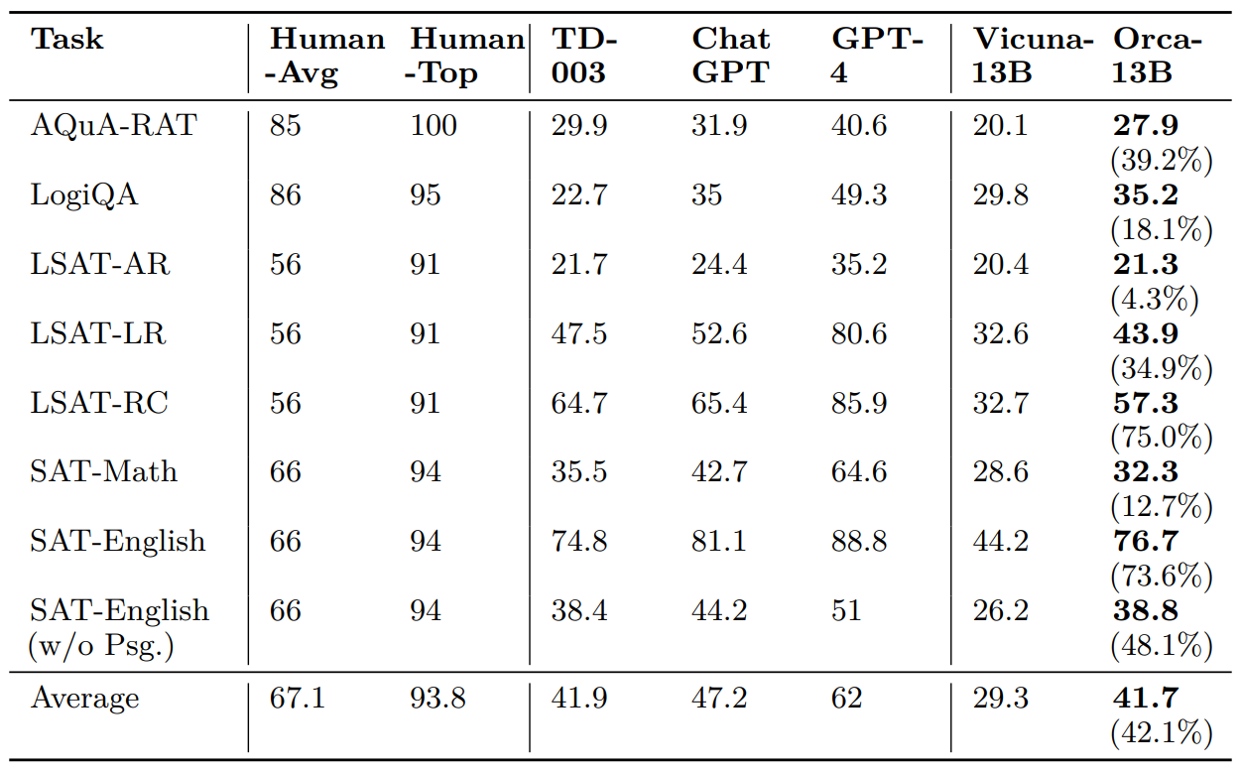
Motivation: Response to The False Promise of Imitating Proprietary LLMs
Approach: Richer learning signal via CoT/Explanations (think: distillation)
Results:
CoT improves both instruction
following and factuality
Re-motivates distillation and
similar teacher/student techniques

Slide 27
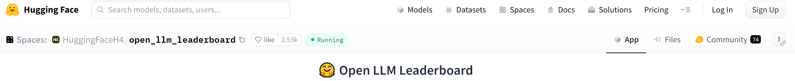
Unified leaderboard for open-source models
4 popular benchmarks:
AI2 Reasoning Challenge (25-shot) - a set of grade-school science questions.
HellaSwag (10-shot) - a test of commonsense inference, which is easy for humans (~95%) but challenging for SOTA models.
MMLU (5-shot) - a test to measure a text model’s multitask accuracy. The test covers 57 tasks including elementary mathematics, US history, computer science, law, and more.
TruthfulQA (0-shot) - a test to measure a model’s propensity to reproduce falsehoods commonly found online.
Seems like a fair proxy for overall model quality (over human preference) – foundation models score relatively well
NOTE: Llama eval may be under-reported, per issue

Slide 28
Quantization

Slide 29
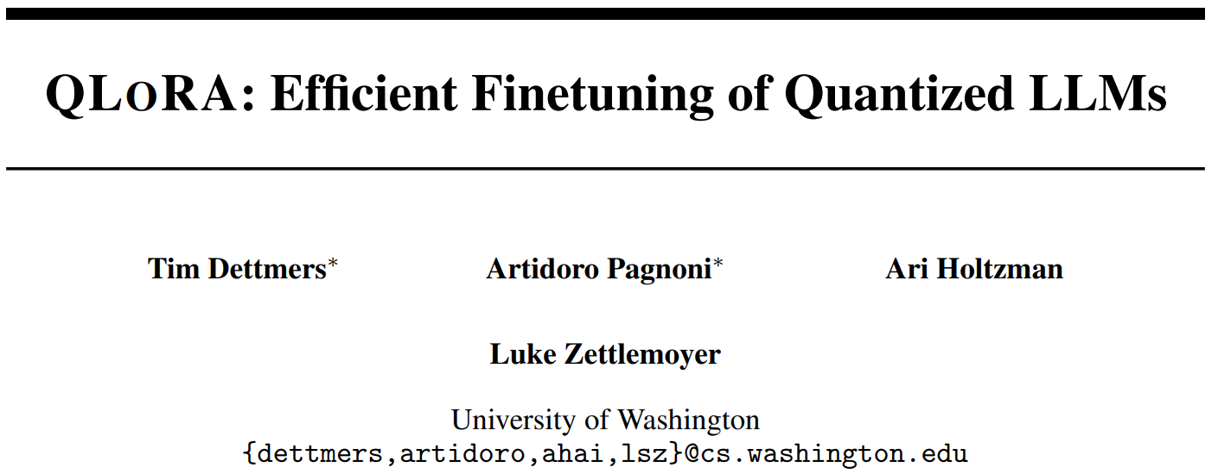
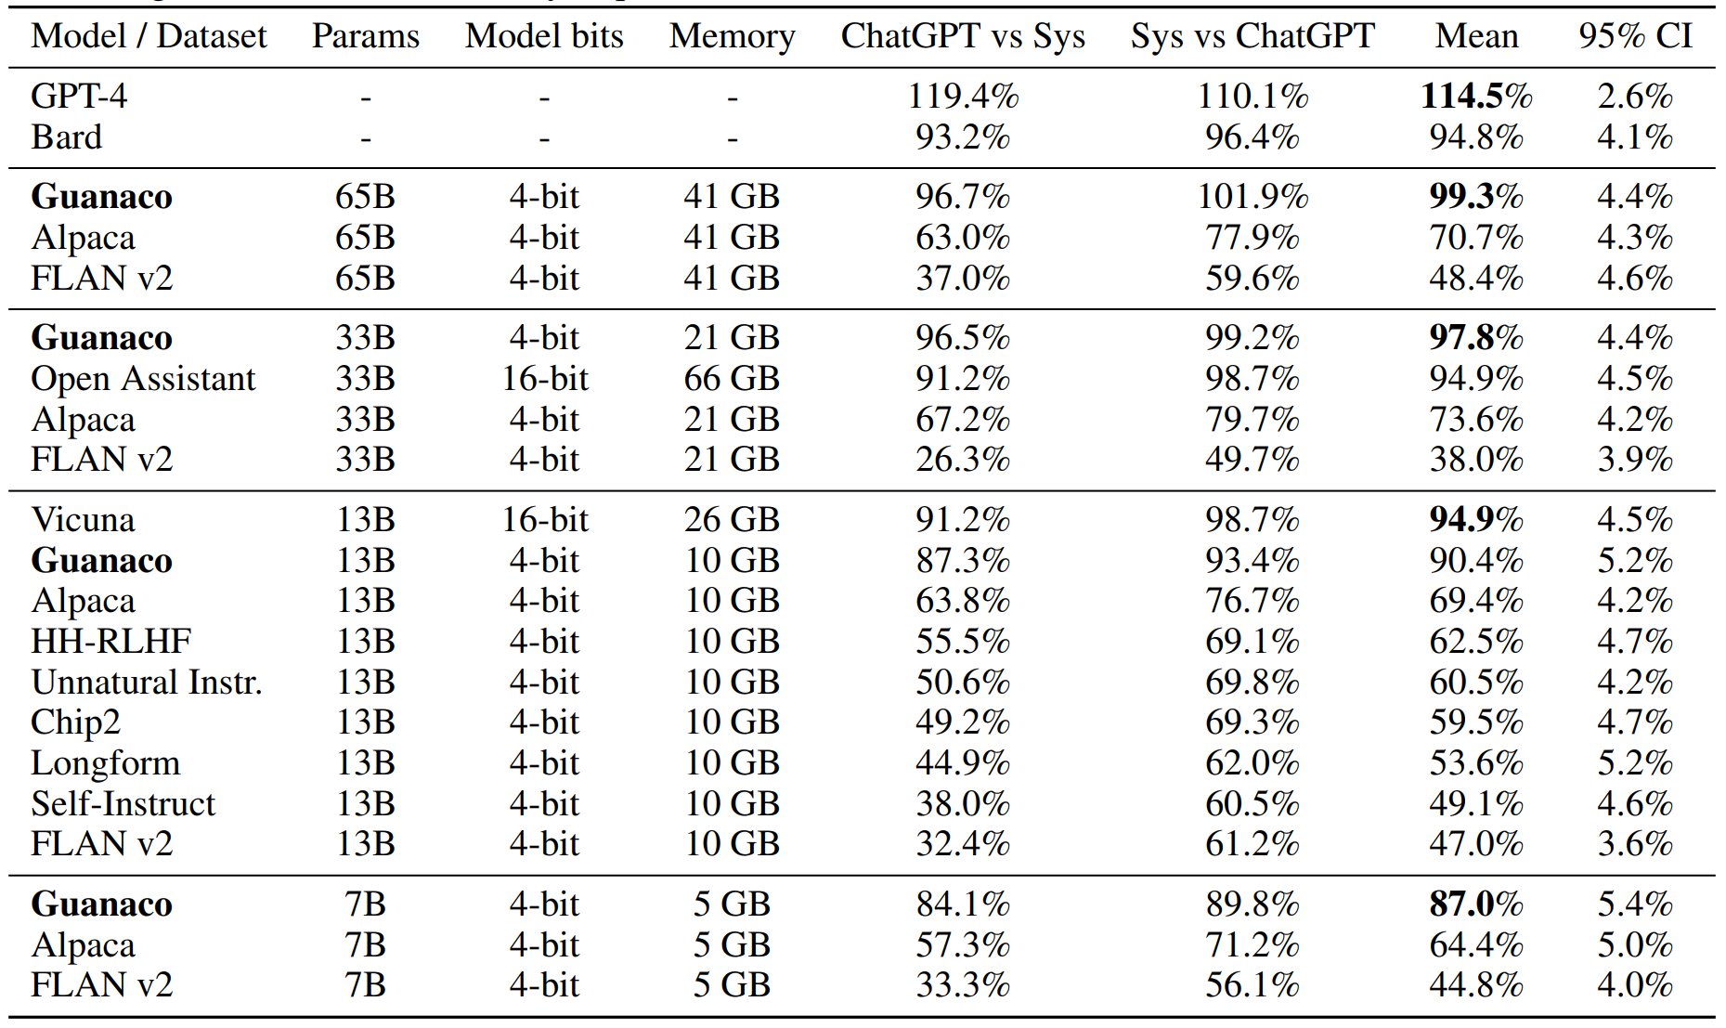
Motivation: Even with LoRA, activation gradients have huge memory reqs
Approach:
Quantize foundation model to 4 bits
Learn LoRA adapters w/ backprop
through quantized weights
Results:
65B Models: 41 GB, single GPU!
No degradation in runtime or quality
Code:
https://github.com/artidoro/qlora
https://github.com/mzbac/qlora-fine-tune

Slide 30
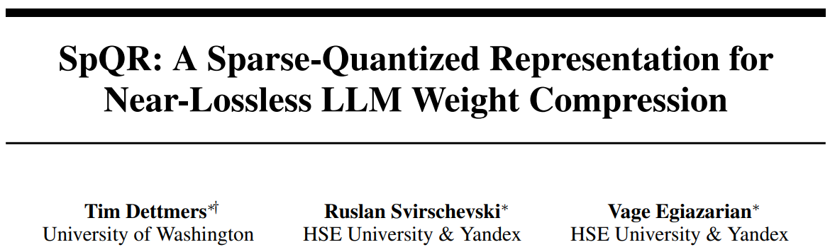
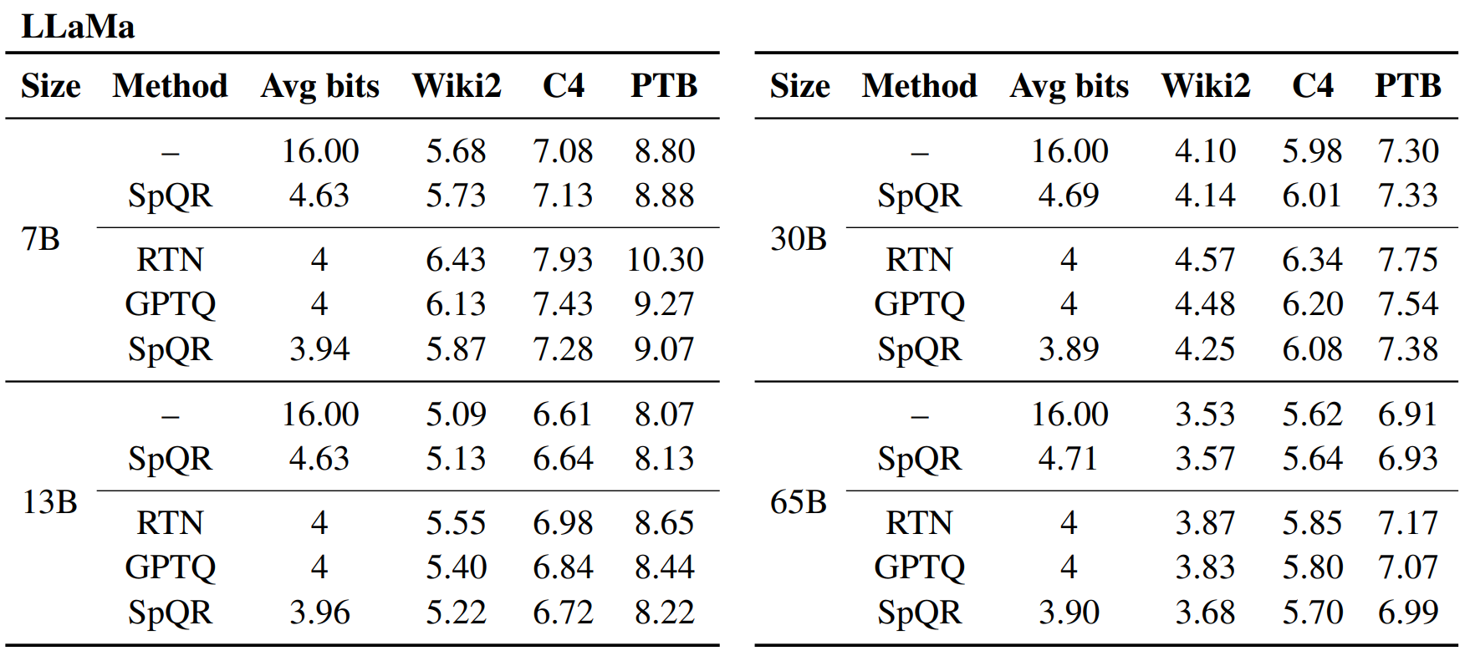
Motivation: Lots of great pretrained models – can we quantize post-training?
Approach:
Not all weights equally important
Sparse-Quantized Representation (SpQR): store outlier weights in higher precision
Results:
<4 bit quantization at ~1% relative
perplexity degradation
https://github.com/Vahe1994/SpQR
Being added to HF inference engine

Slide 31
RLHF & Alternatives

Slide 32
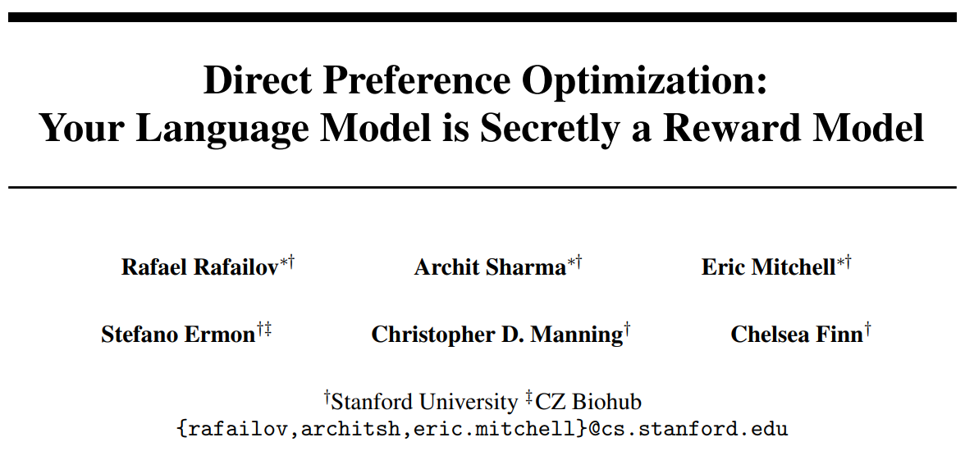
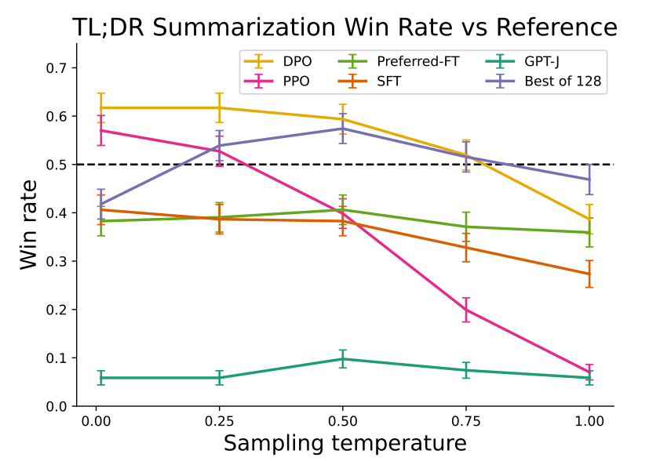
Motivation: RLHF has many moving parts – can we simplify?
Approach:
Do some math
Derive DPO update rule that optimizes LM
exactly, in a single stage, for human preference
Results:
Less computationally expensive
More stable training

Slide 33
Conclusions
Low-budget, general-purpose imitation models (Vicuna, Alpaca) are less capable
Progress being made nonetheless: Guanaco, Falcon, Tulu > Vicuna, Alpaca
Fine-tuning recipes:
Single-domain fine-tuning w/ synthetic labels
Distillation of LLM into small model w/ rich training signal
Distillation of LLM into small model in single domain
Evaluating generative output is hard
Can fool yourself if you measure the wrong thing
Quantization can help make LLMs fit in memory, but they’re still slow!
DPO + lots of feedback collection = aligned open-source model soon?

